Slide 1
Midterm pROJECT
Face Classification for My Cats
Vikki

Slide 2
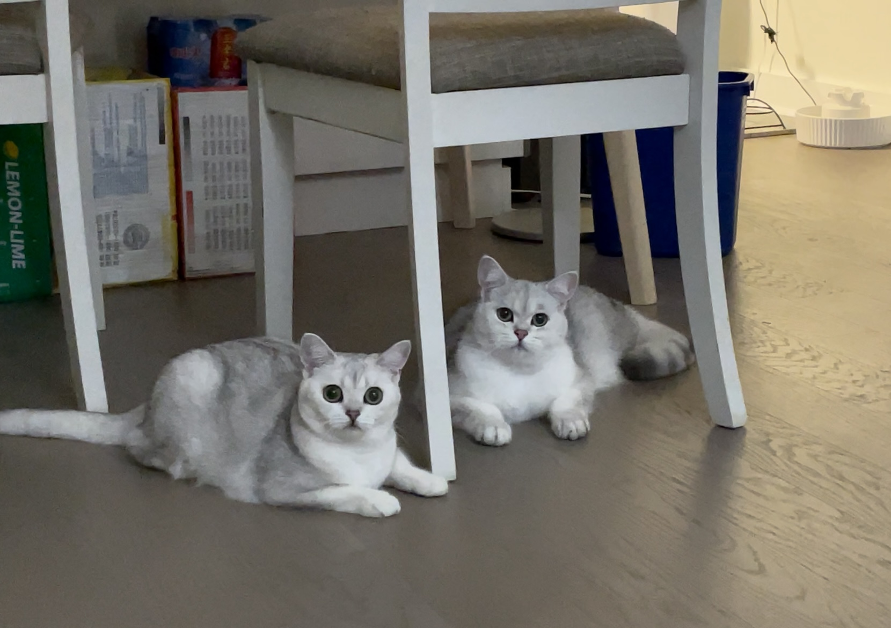
mY CATS:

Slide 3
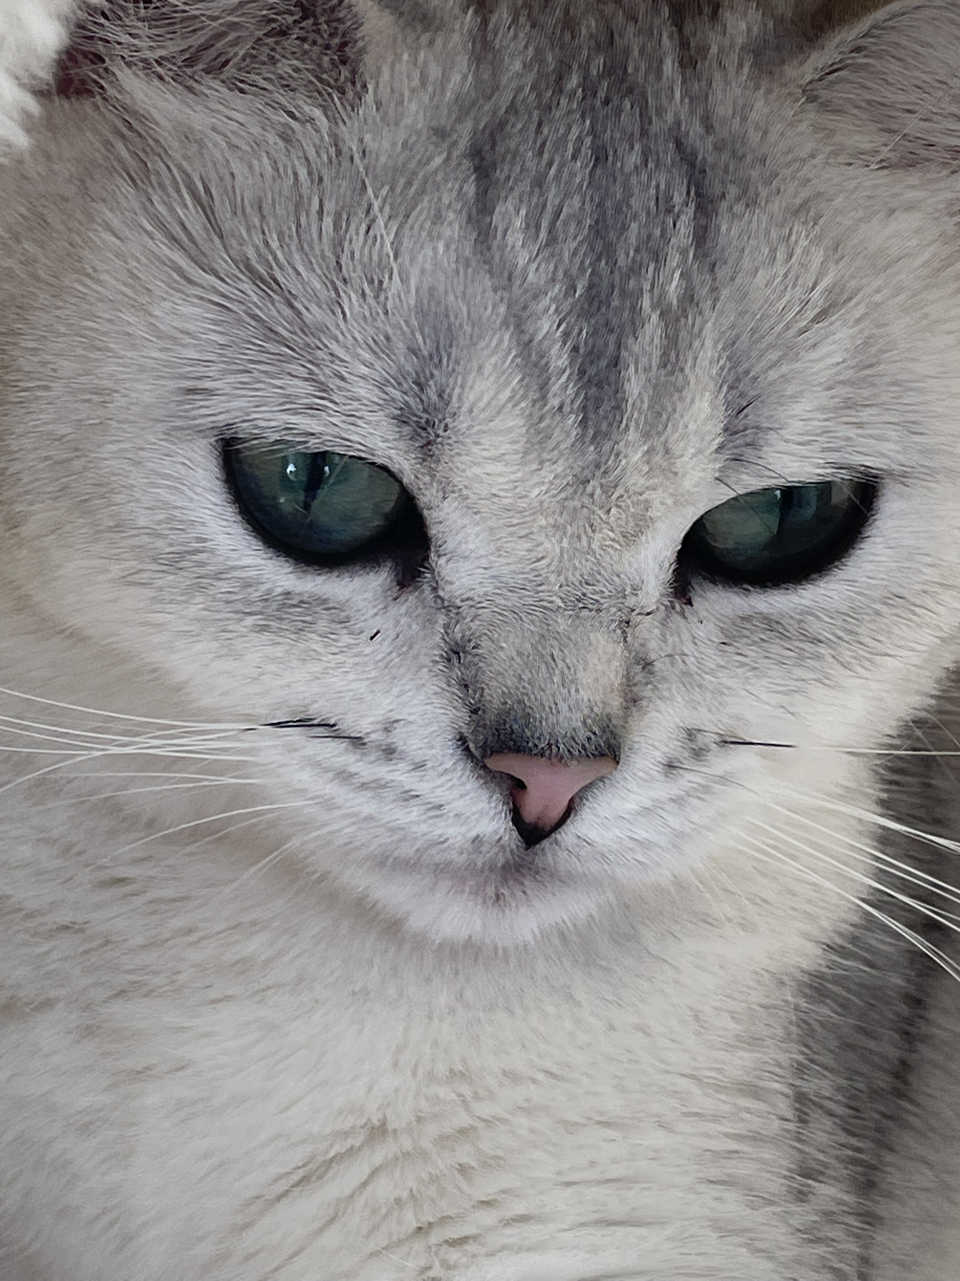
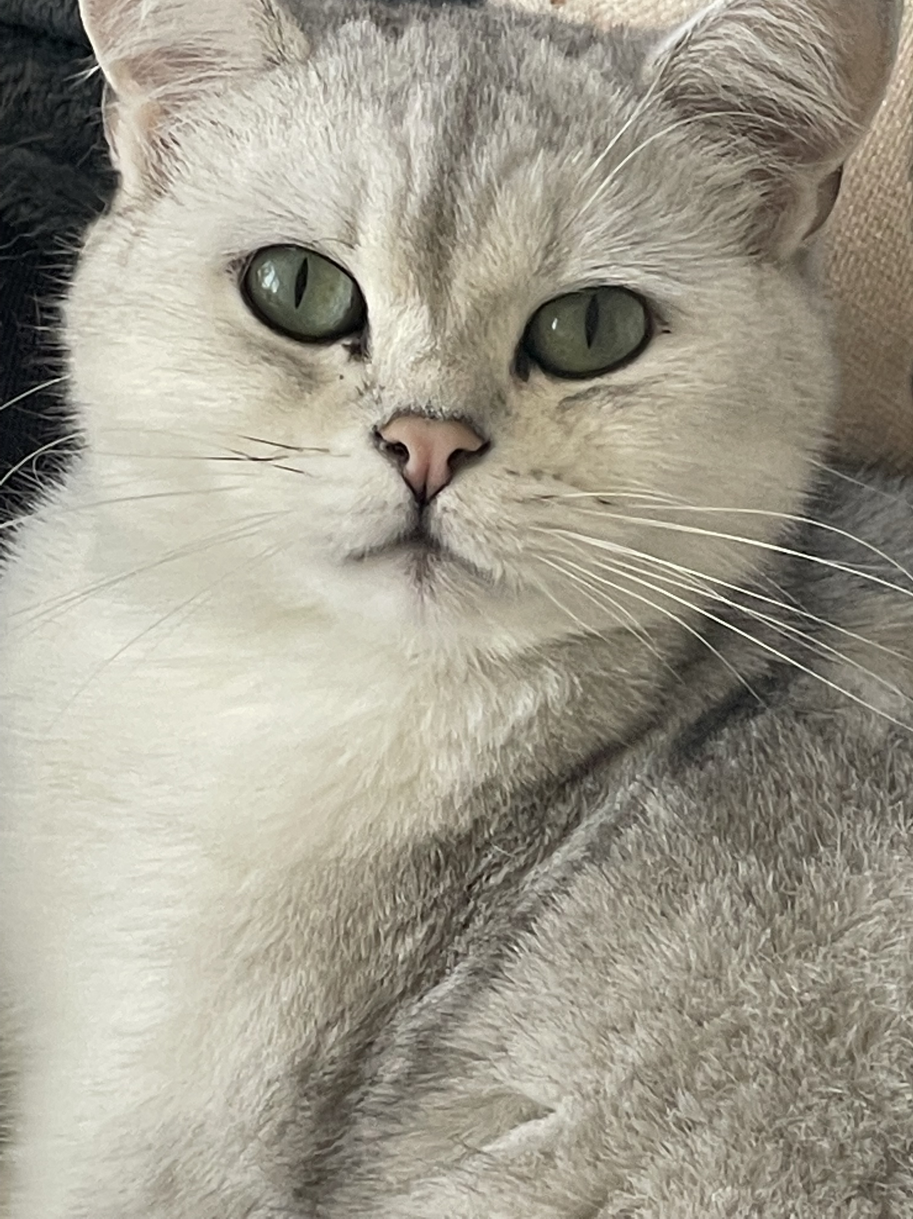
Milky
Cookie

Slide 4
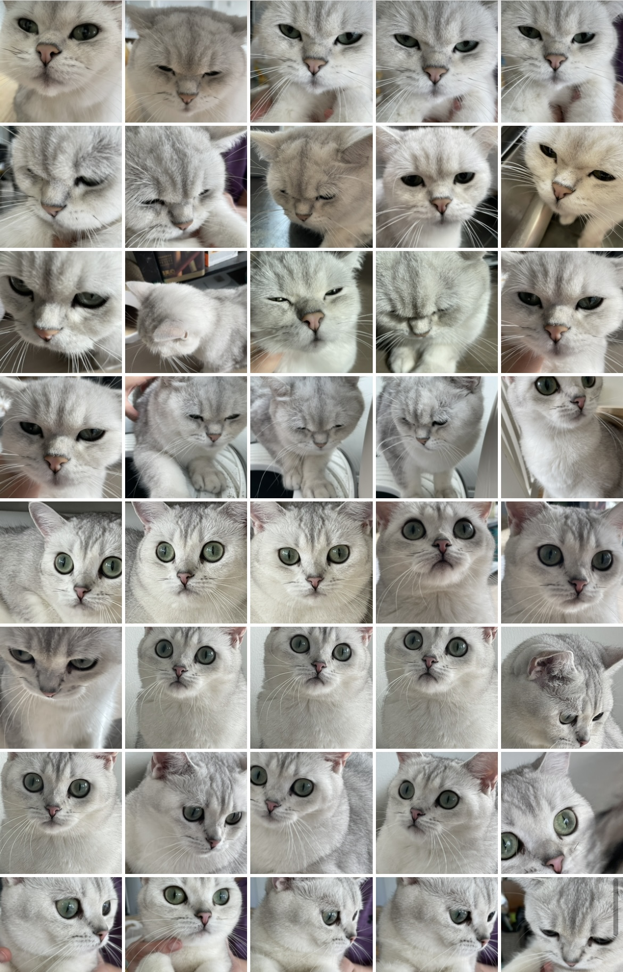
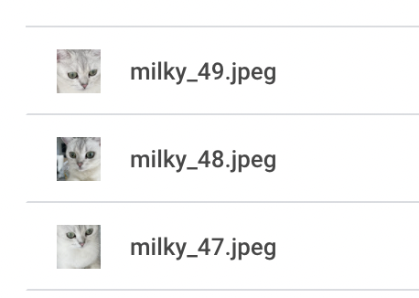
The dataset
The photo were taken only on the face, to avoid the influence of background information
50 images for each cat
Random shuffle, 30 train, 10 validation, 10 test
Using OS package, to create the following directory:
Train/validation/test -> cookie/milky -> cookie_i

Slide 5
preprocessing
Rescale: 1/255, because RGB is in [0, 255]
Resize: (192, 192, 3)
Train batch size: 10, validation batch size: 4
Data augmentation:
rotation range: 40
width_shift_range: 0.2
Hight_shift_range: 0.2

Slide 6
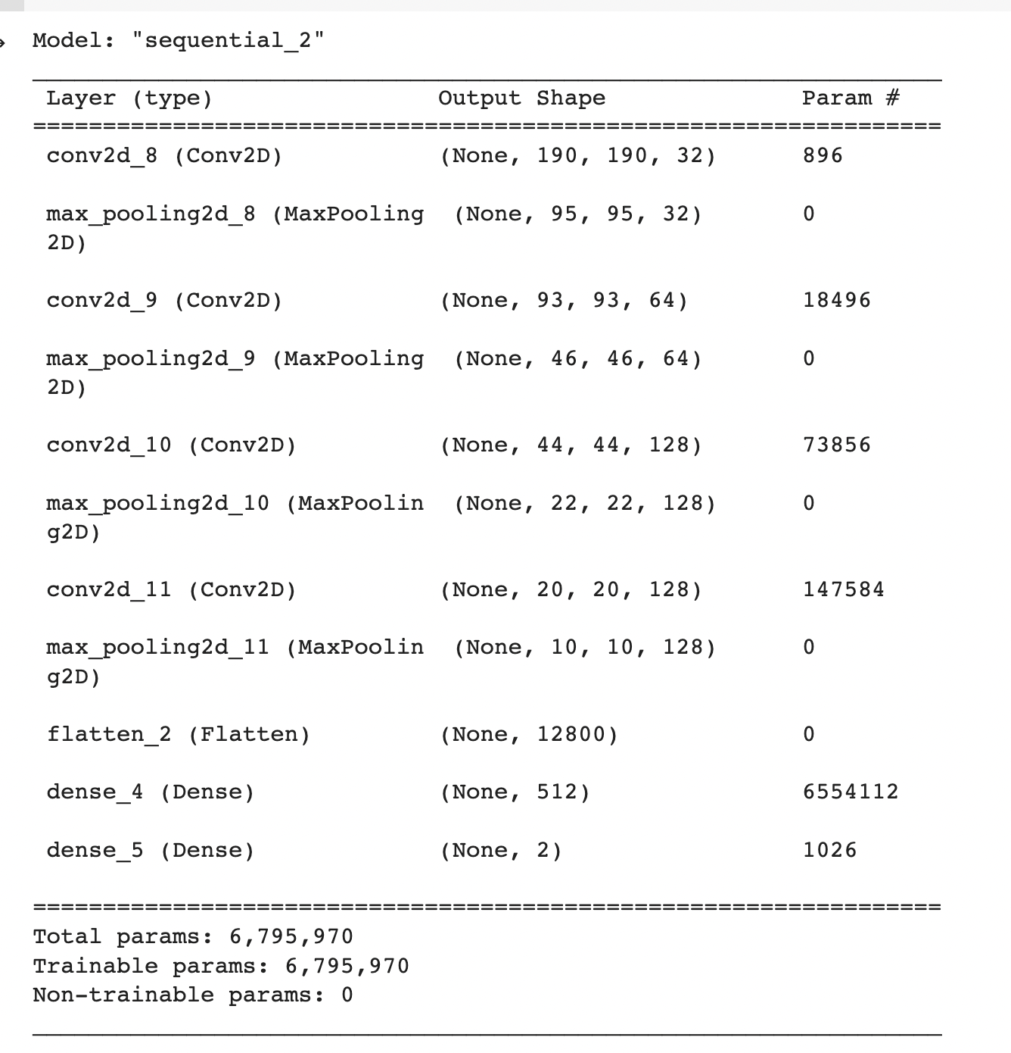
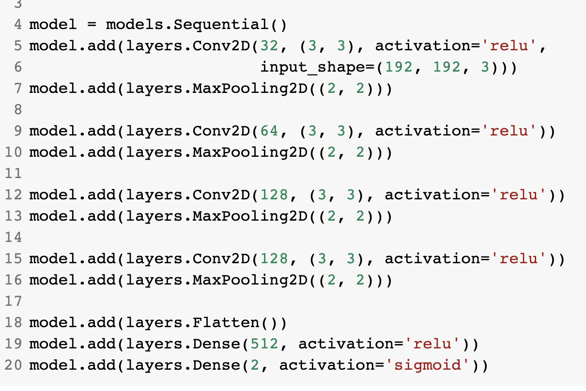
My model:

Slide 7
TRAINING THE MODEL:
Loss: binary cross entropy loss
Optimizer: RMSprop with learning rate 1^-4
Early stopping based on the validation loss, stopping training when val_loss no longer decrease for three epoch
Train the model for 20 epochs

Slide 8
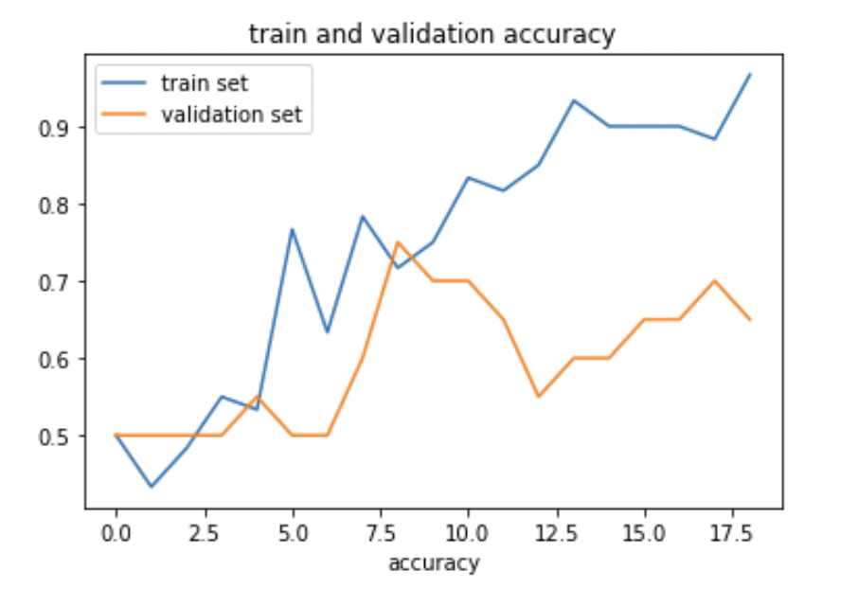
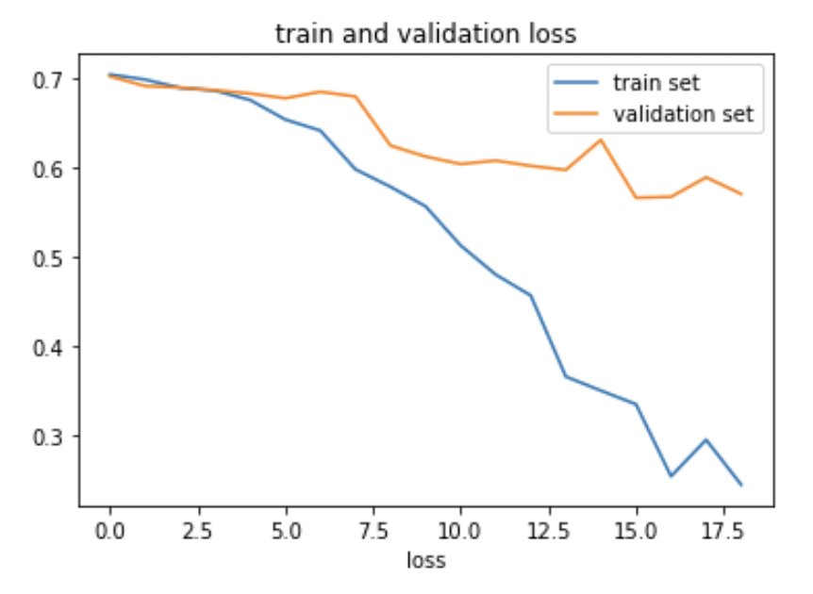
Model1: my model with no augmentation

Slide 9
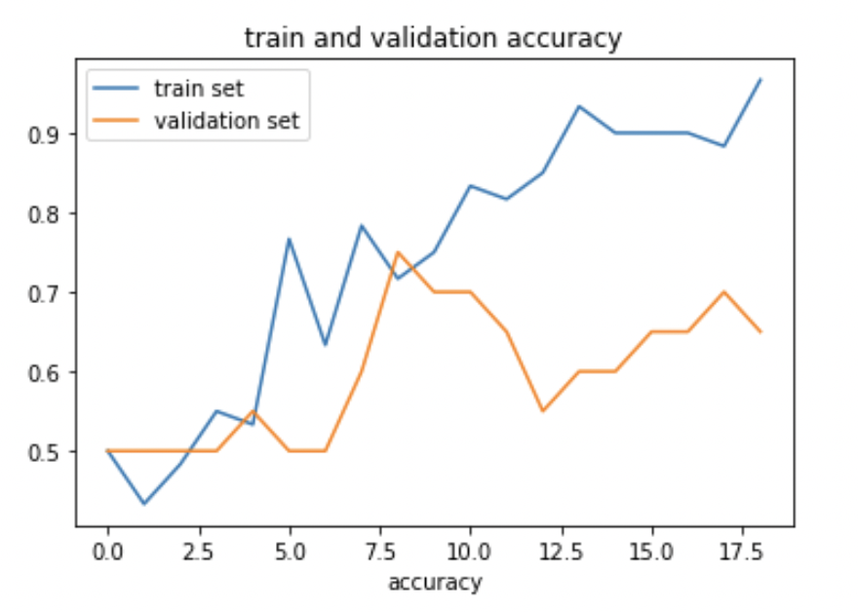
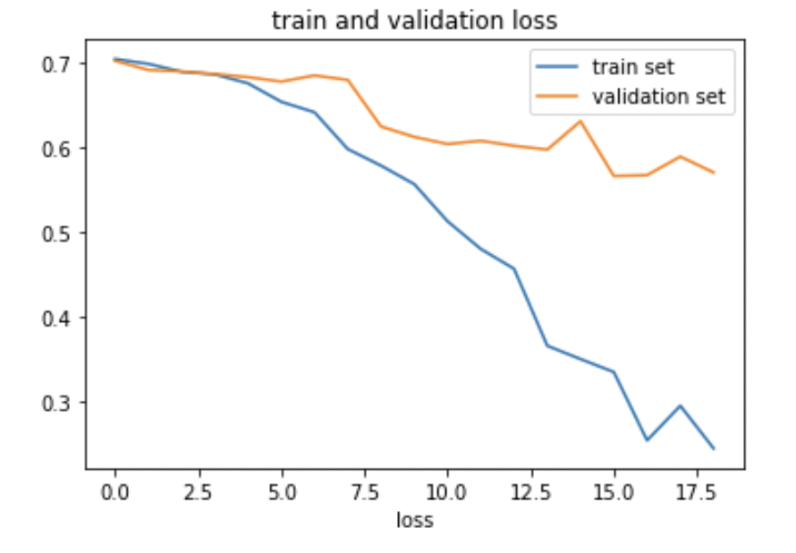
Model2: my model with augmentation

Slide 10
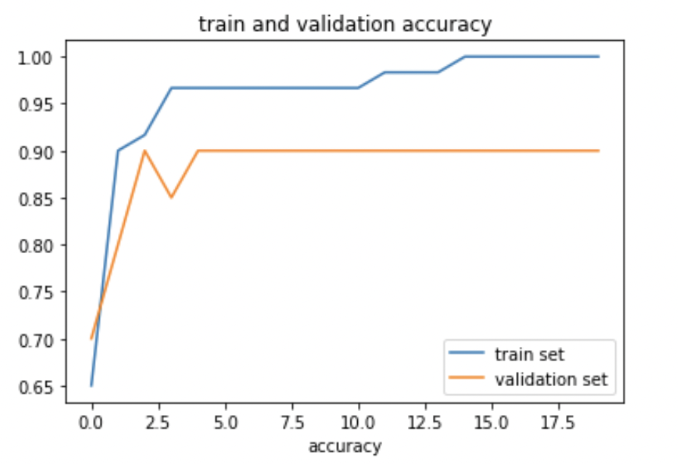
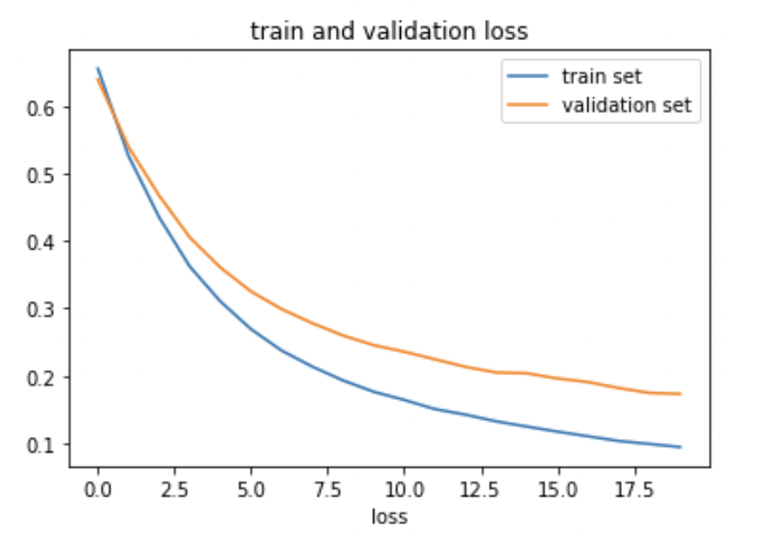
Model3: MobileNetV2 with my dense no augmentation

Slide 11
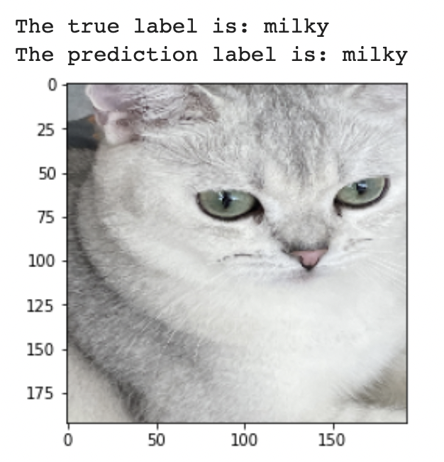
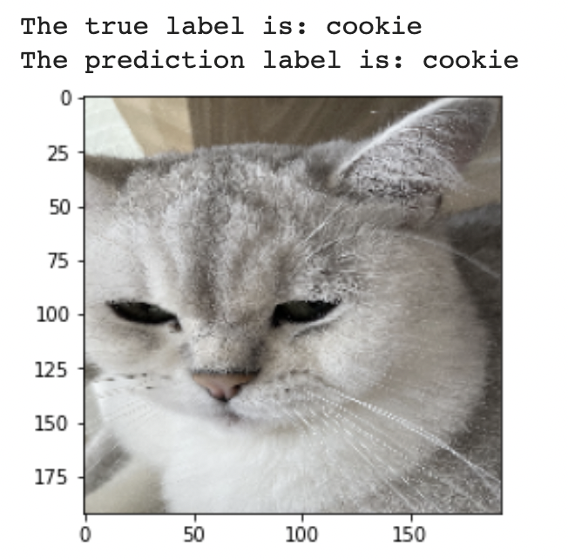
Performance On the test set
Accuracy on the test set is: 0.95
Some examples:

Slide 12
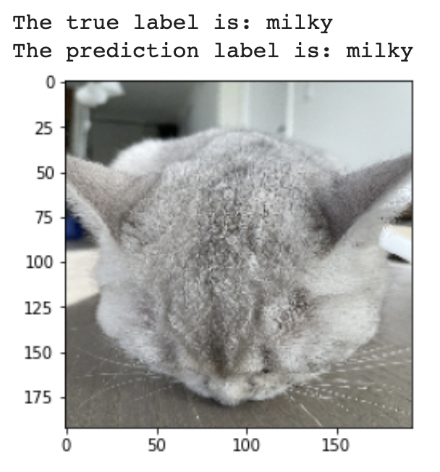
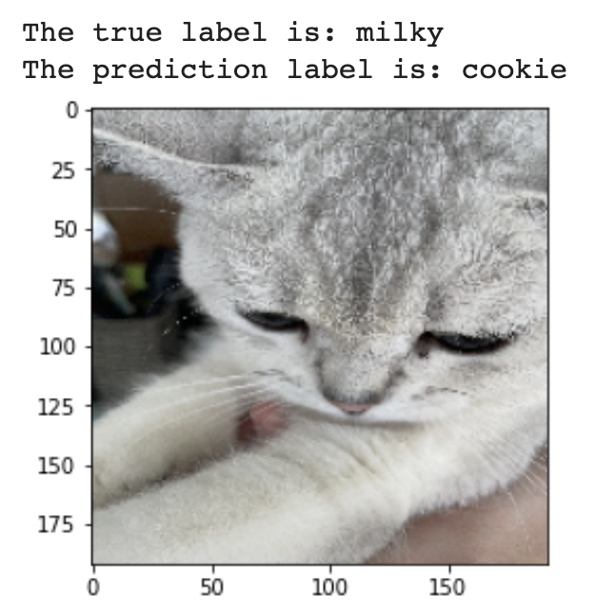
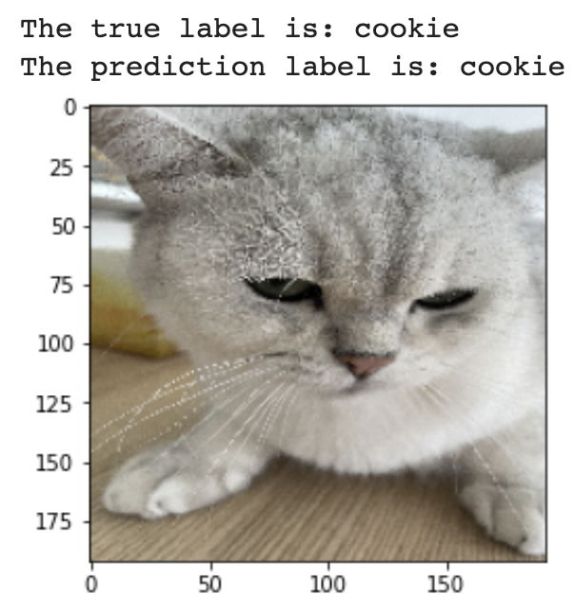
Performance On the test set
Accuracy on the test set is: 0.95
Some examples:

Slide 13
Applications:
Can be used for family with multi-pets, to monitor the the performance of each pet.
Improvement: reduce the number of dataset that is required to train the model

